Slide 1
Designer Can Code
Lecture 1
By Tom Lau

Slide 2
Who Am I
Name : Lau Ka Kin, Tom
Major : Computer Engineering, year 3
Facebook : lkakin9125@gmail.com

Slide 3
Take Home
Android

Slide 4
Take Home
Basic Knowledge of Android APP
How to create a Android layout using xml
Basic Android programming concept
Drawing basic graphic by xml
Basic Android Animation

Slide 5
Basic Knowledge of Android APP
Android Studio is an
Integrated Development Environment.

Slide 6
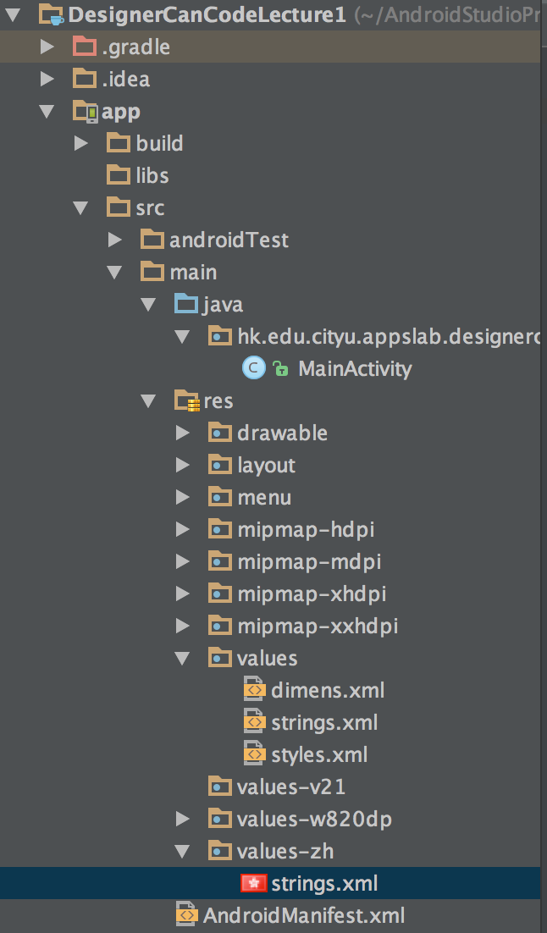
Android Studio Project
Each App can consider as a project
Different resources should put it different folder
Qualifier(post fix) are help the system to select the right folder

Slide 7

Basic Knowledge of Android APP
Android APP
JAVA
(Logical Code)
Picture
(most likely PNG)
XML
(layout, graphic, animation….)

Slide 8
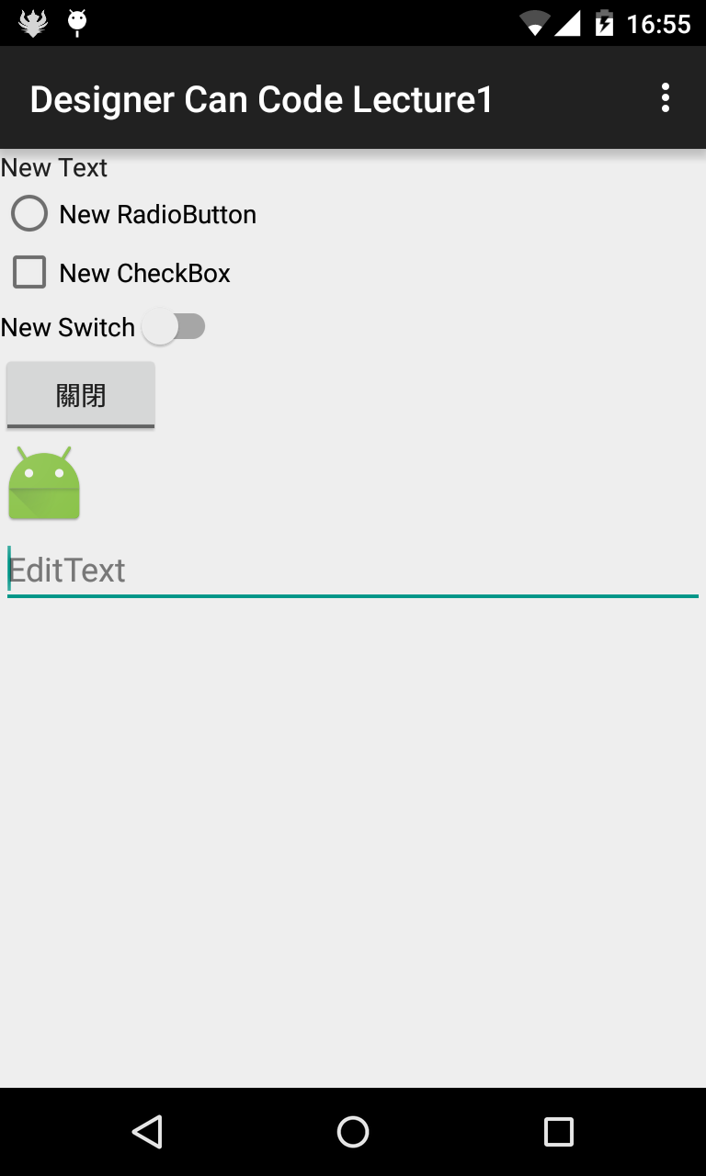
Android Layout
Every thing that on the layout we call it View

Slide 9
View
Every thing that on the screen we call it View
For each View, width and height properties are needed
For setting width or height, we can use match_parent, wrap_content and x dp

Slide 10
Layout
Layout is a view that contain views so that the position of view can be controlled
In this lecture, LinearLayout and RelativeLayout will be used.

Slide 11
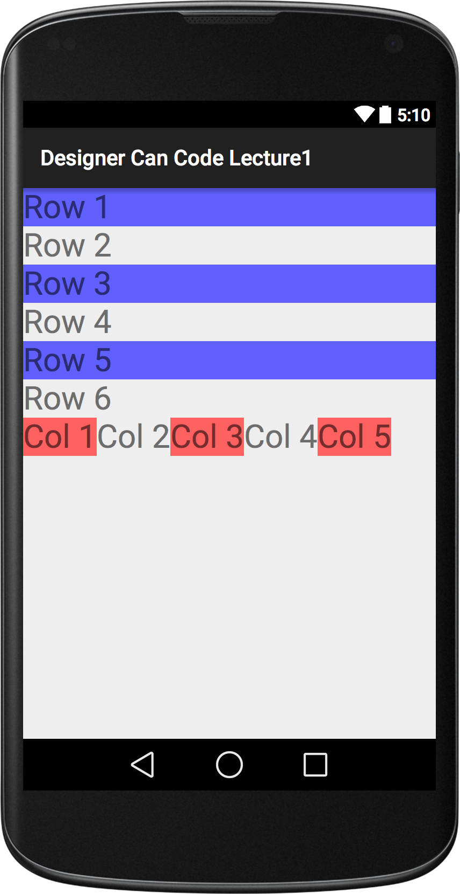
LinearLayout
It show the view as a stack
It can set the orientation to show the child views vertically or horizontally

Slide 12
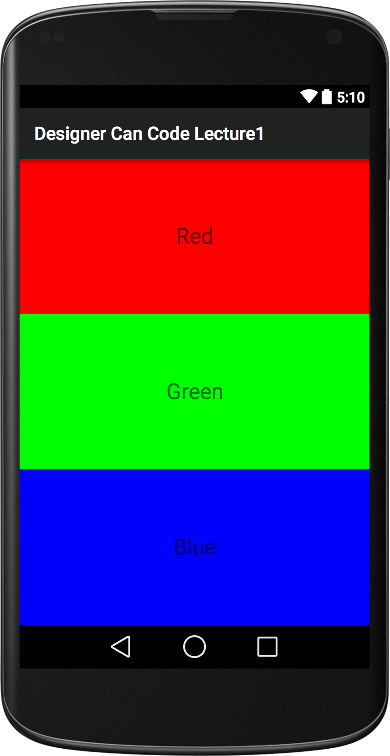
LinearLayout
In LinearLayout, a property, weight, allocate the width or height.

Slide 13
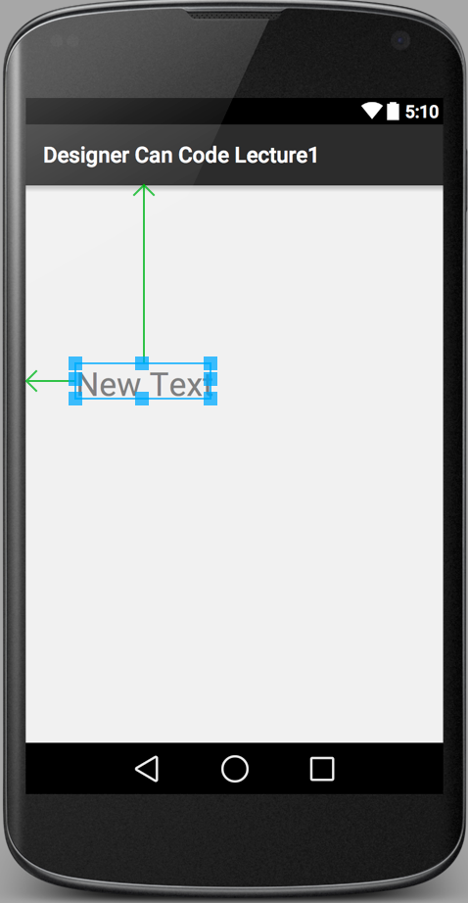
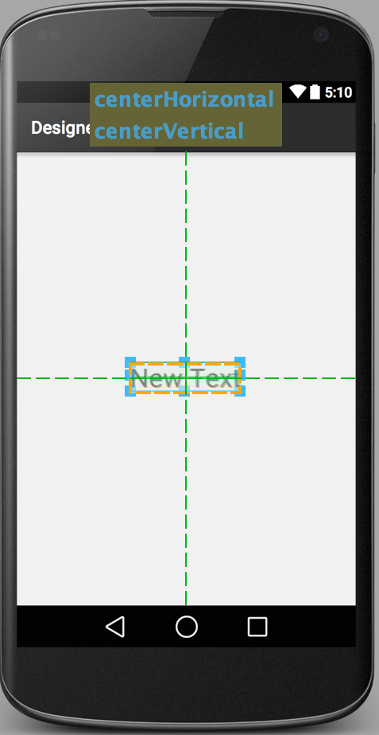
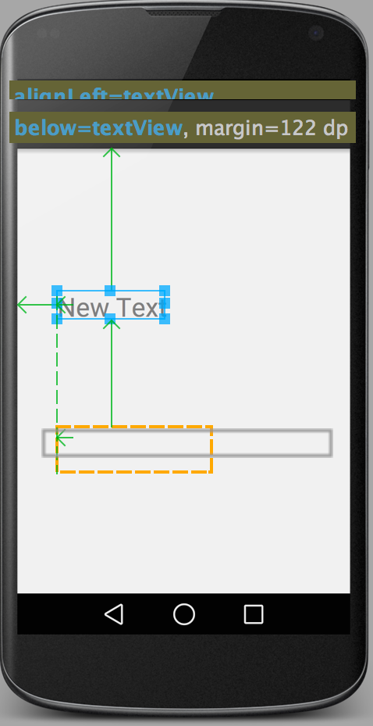
RelativeLayout

Slide 14
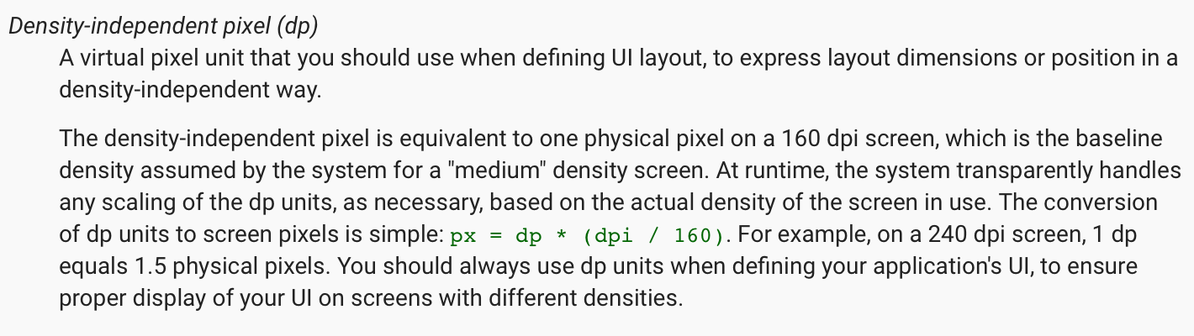
What is dp

Slide 15
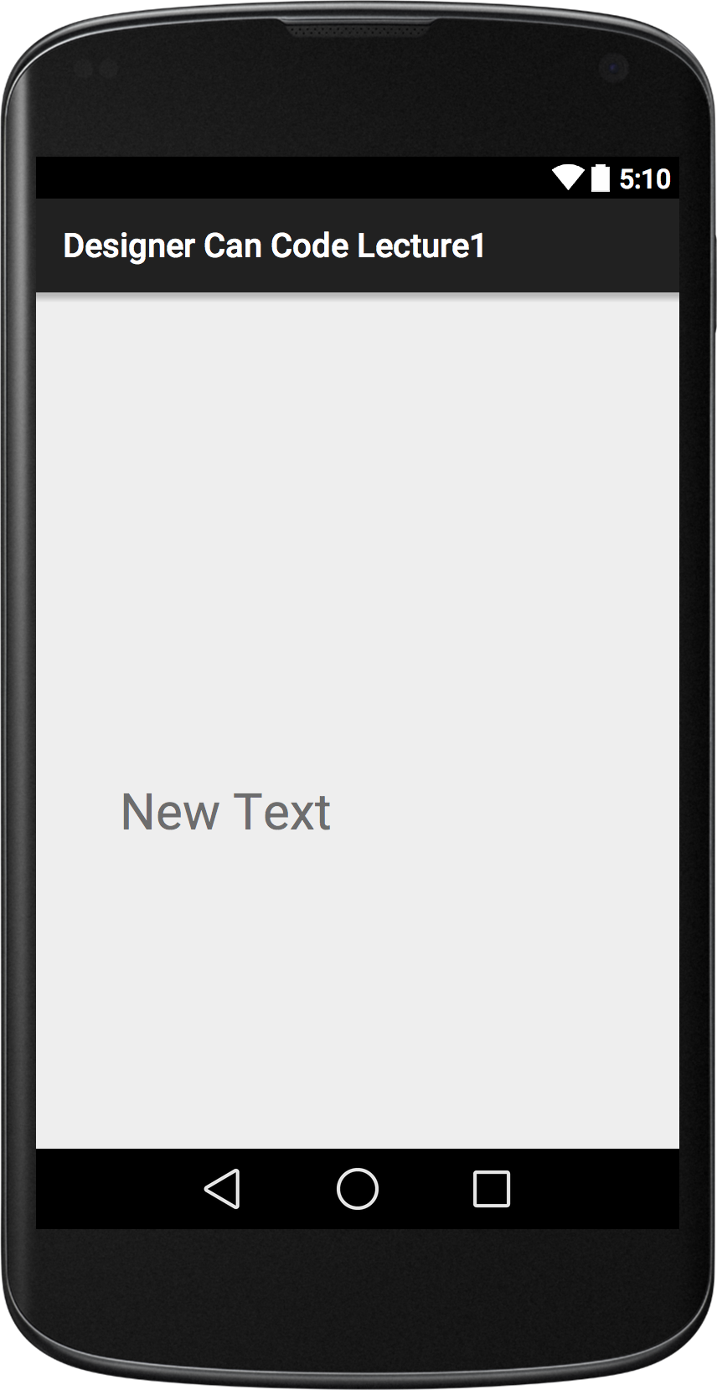
padding and margin
paddingLeft = 50dp | marginLeft = 50dp

Slide 16
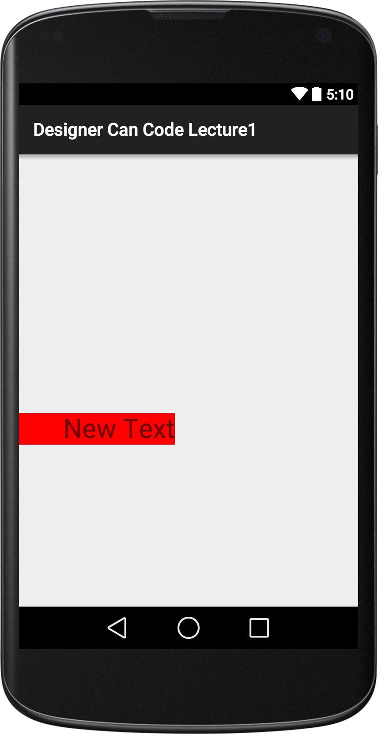
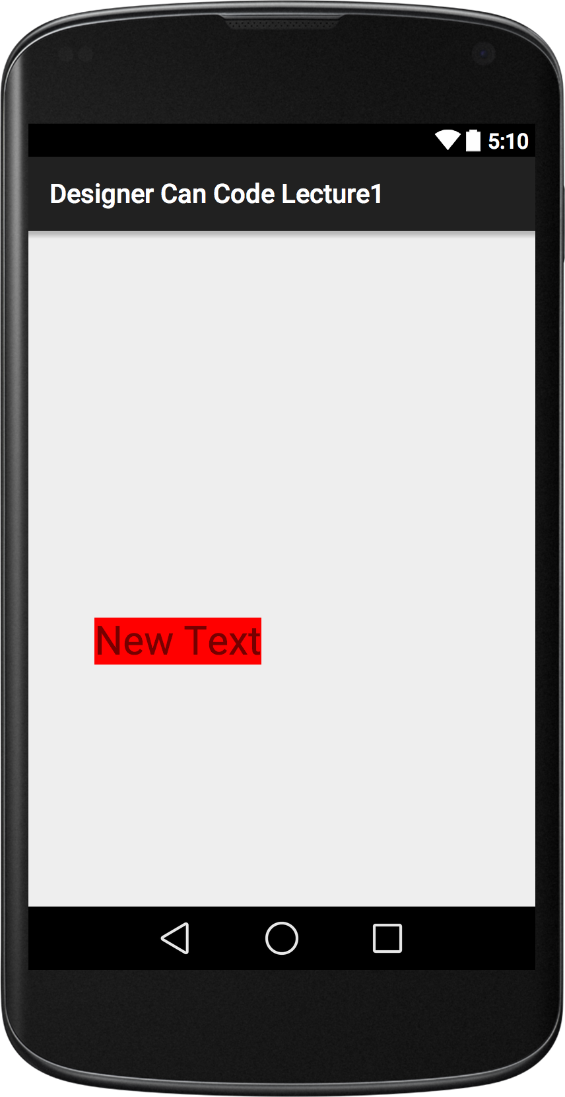
padding and margin
paddingLeft = 50dp background="#FF0000" | marginLeft = 50dp background="#FF0000"

Slide 17
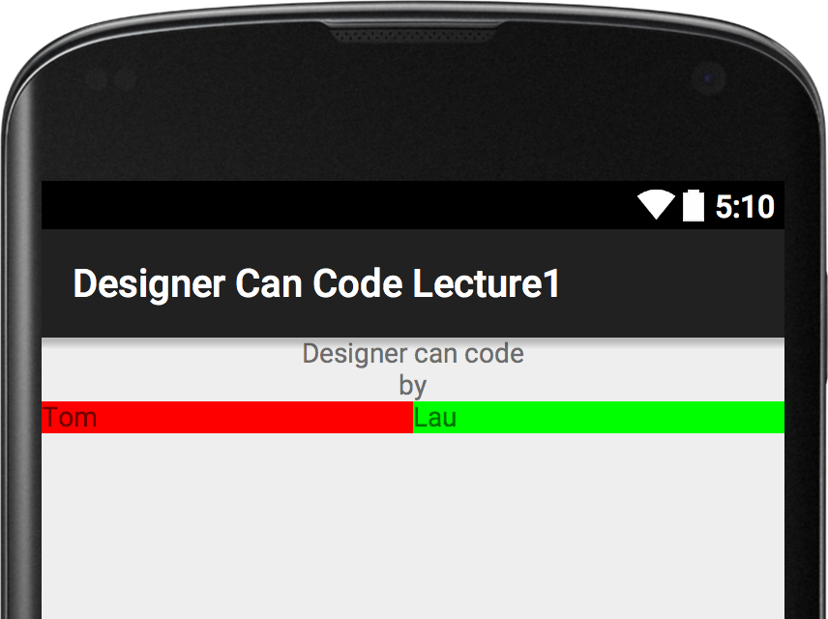
Demo
Drag and Drop a simple layout

Slide 18
What is XML
Extensible Markup Language (XML) is a markup language that defines a set of rules for encoding documents in a format which is both human-readable and machine-readable. It is defined by the W3C's XML 1.0 Specification and by several other related specifications, all of which are free open standards. (From Wikipedia)

Slide 19
What is XML
Extensible Markup Language (XML) is a markup language that defines a set of rules for encoding documents in a format which is both human-readable and machine-readable. It is defined by the W3C's XML 1.0 Specification and by several other related specifications, all of which are free open standards. (From Wikipedia)

Slide 20
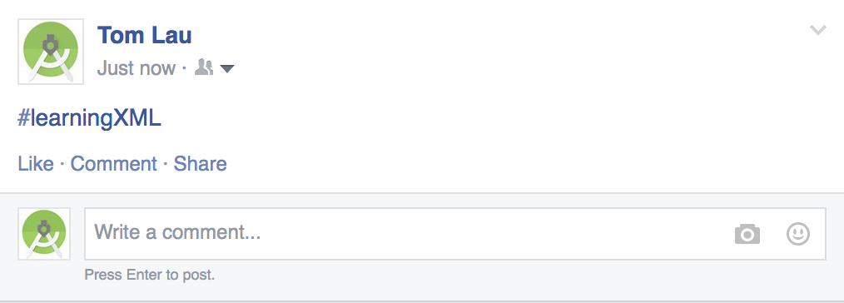
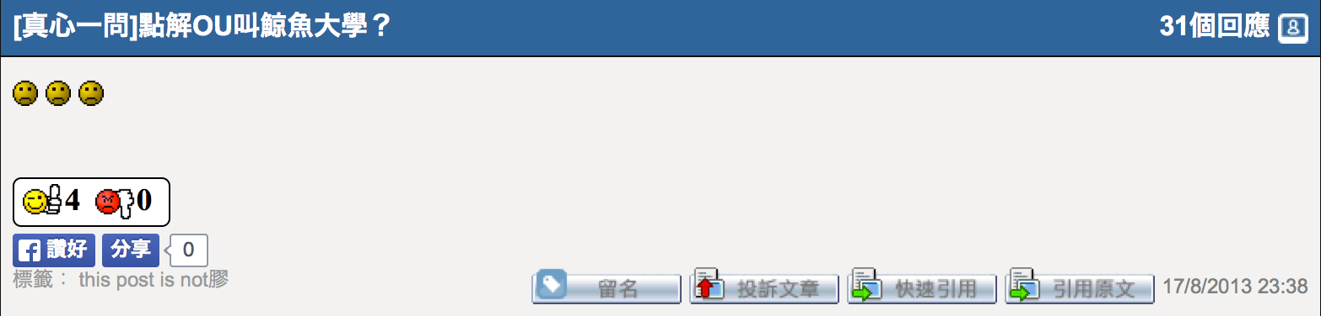
What is XML

Slide 21
What is XML
<TextView
android:layout_width="wrap_content"
android:layout_height="wrap_content"
android:text="Learning"/>
<TextView
android:layout_width=“wrap_content"
android:layout_height="wrap_content"
android:text="Android"></TextView>

Slide 22
Demo
Write a simple layout by xml

Slide 23
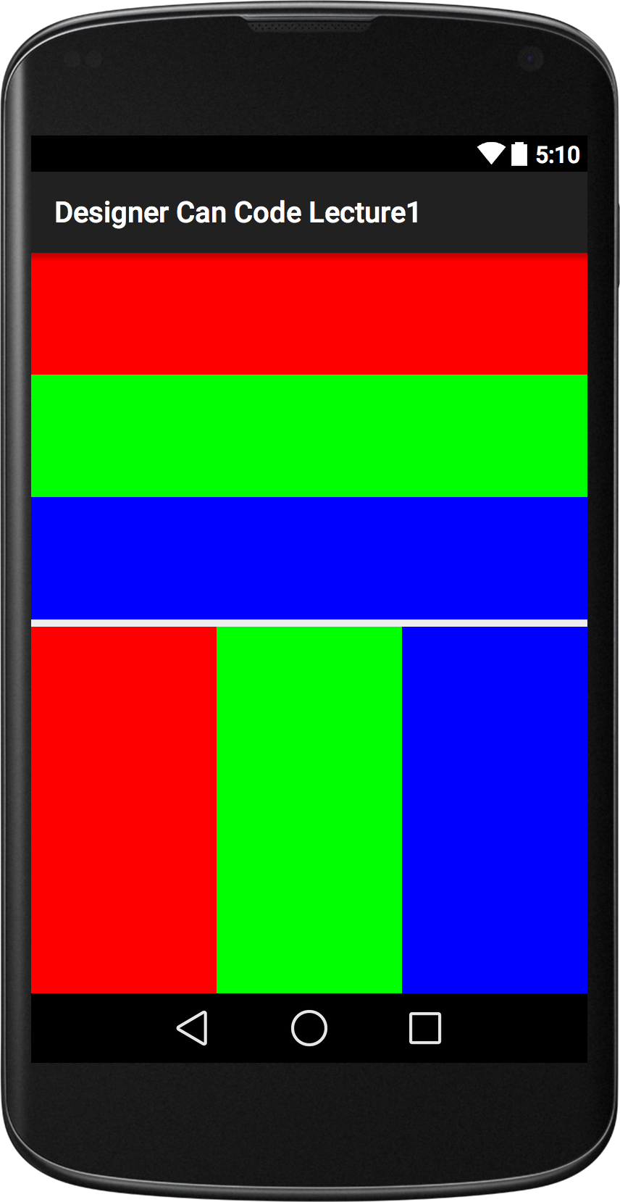
Task 1
(LinearLayout only)

Slide 24
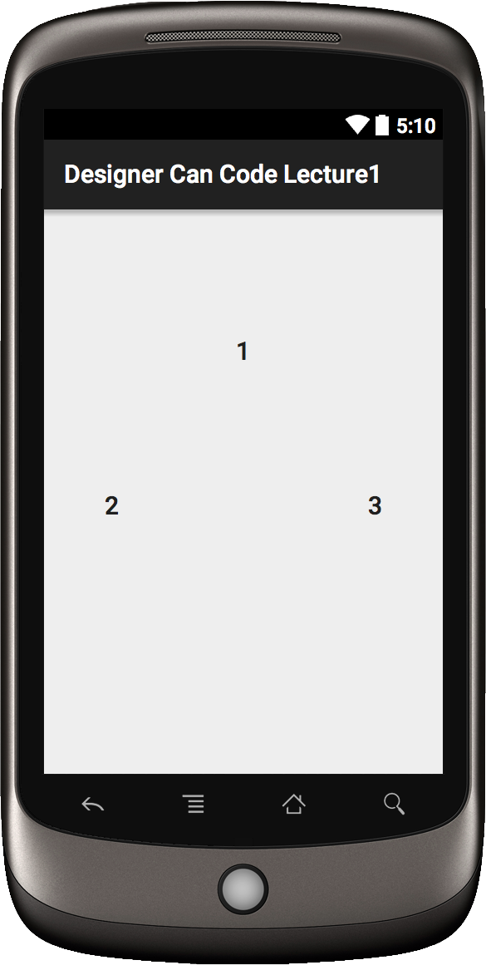
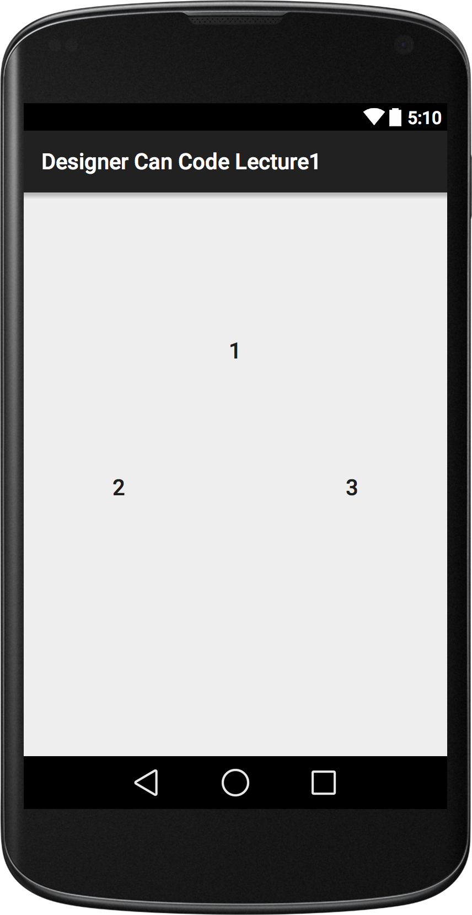
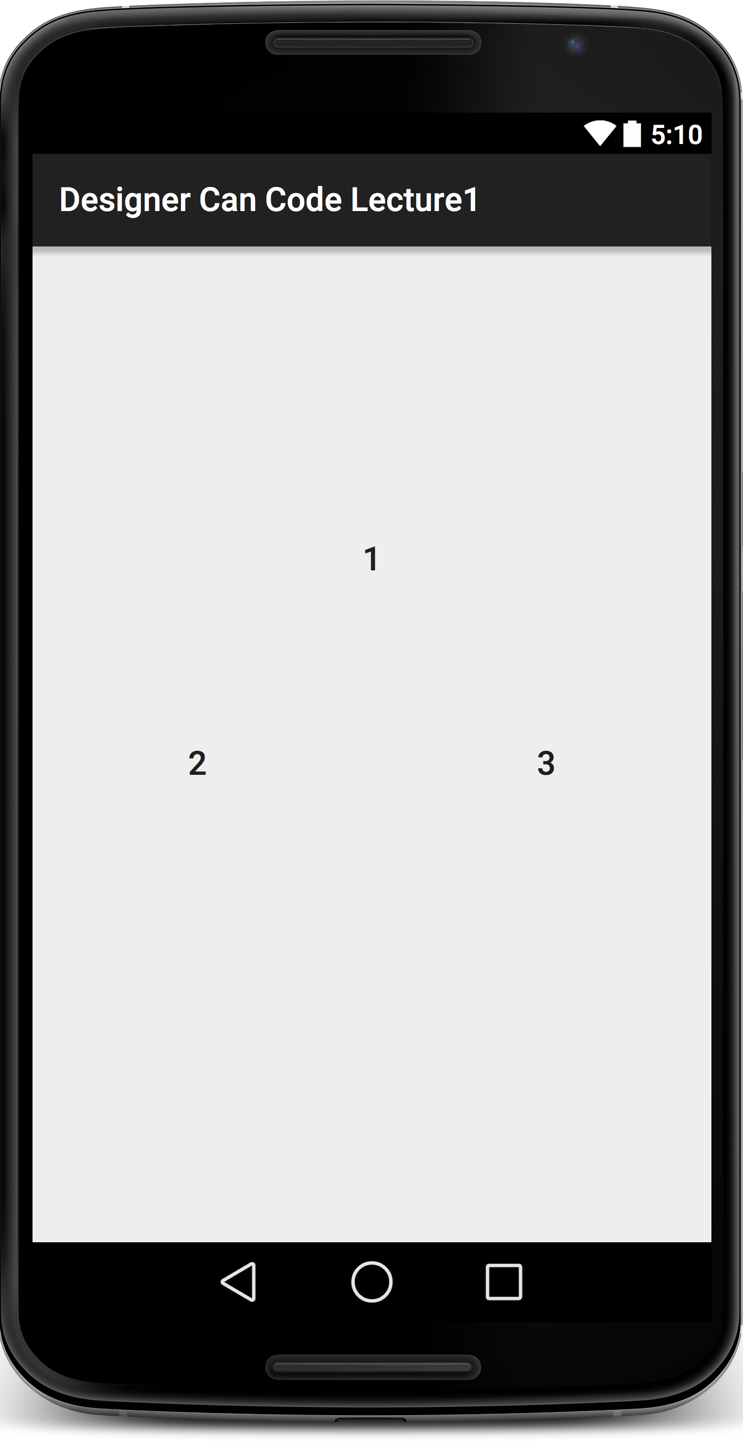
Task 2

Slide 25
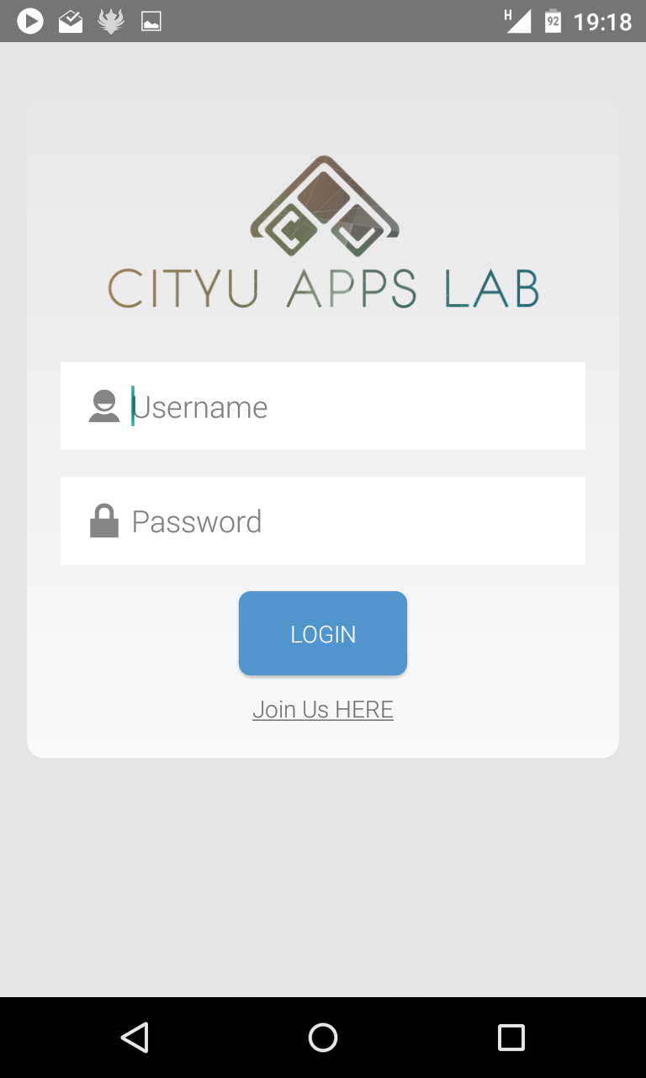
Task 3

